Slide 1

Exploring the plant resistant gene complement using RenSeq
(R gene Enrichment and Sequencing):
from discovery to application
Kamil Witek
01/08/2017
TSL summer school

Slide 2
Presentation overview
1. Introduction - plant immune system
Disease resistance genes
RenSeq
2. Basic research
NLR complements of Solanaceae
3. Cloning of functional resistance genes
RenSeq with Bulked Segregant Analysis
MutRenSeq
4. Applied research
transgenic field trials
Maris Piper⁺ (HAPI project)

Slide 3
Presentation overview
1. Introduction - plant immune system
Disease resistance genes
RenSeq
2. Basic research
NLR complements of Solanaceae
3. Cloning of functional resistance genes
RenSeq with Bulked Segregant Analysis
MutRenSeq
4. Applied research
transgenic field trials
Maris Piper⁺ (HAPI project)

Slide 4
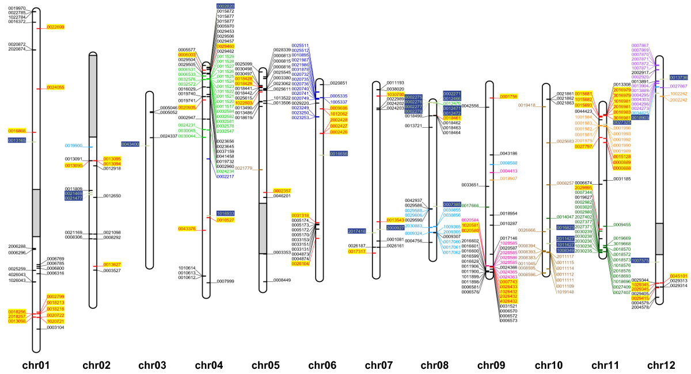
1.1
NLRs: highly repetitive, clustered gene family
Jupe et al. (2012) BMC Genomics
organized in clusters
hundreds to thousands of NLRs in plant genomes

Slide 5
1.2
RenSeq: R gene enrichment and Sequencing
Design
N terminus
NB
ARC
LRR
NLRs
0.2% genome
RNA baits
Enrichment
+
Biotinylated RNA baits
Sheared DNA
DNA-RNA
hybrids
NLR enriched
sample
Results
High throughput sequencing
50x
~50%
NLR reads
coverage
0
Jupe, Witek et al. (2013) Plant J
Notes:
Any multigenic family, any organism

Slide 6
1.2
Reannotation of potato genome
revealed over 300 additional NLR genes
green – previously annotated NLR genes (438)
purple – additional NLR genes reannotated with RenSeq (338)
Jupe, Witek et al. (2013) Plant J

Slide 7

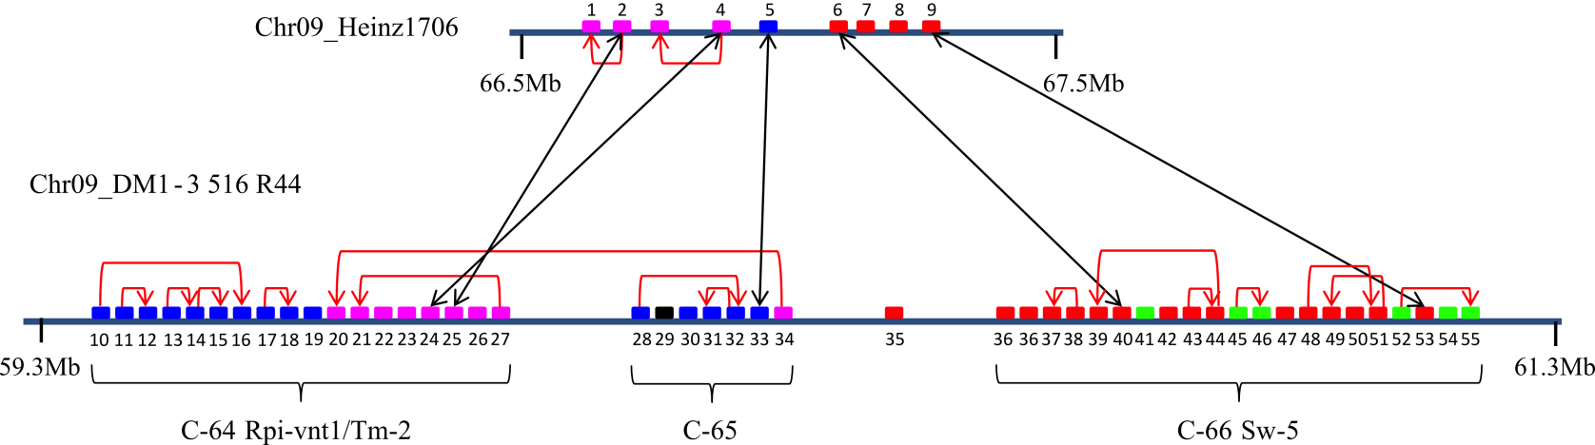

1.2
Substantial increase in potato vs. tomato NLR cluster size
Tm-2/Rpi-vnt1/Sw-5 cluster on Chr09
high syntenic conservation
large cluster expansion in potato
Andolfo et al. (2014) BMC Plant Biol

Slide 8
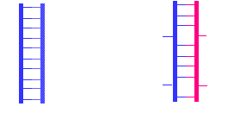
1.2
Solanaceae-wide de novo NLR annotations
using potato baits
 |  | RenSeq
Solanaceae species | prior art | confirmed | novel | total | NGS platform
Solanum tuberosum clone DM¹ | 438 | 424 | 338 | 755 | GAII | gDNA
Solanum americanum ². | - | 654 | 654 | 654 | MiSeq, PacBio | cDNA, gDNA
S. lycopersicum Heinz 1706³ | 294 | 221 | 105 | 326 | MiSeq | cDNA, gDNA
S. pimpinellifolium LA1589³ | - | - | 355 | 355 | MiSeq | cDNA, gDNA
Nicotiana benthamiana Nb-1⁴ | - | - | 305 | 305 | MiSeq | gDNA
N. sylvestris⁴ | - | - | 472 | 472 | MiSeq | cDNA, gDNA
N. tomentosiformis⁴ | - | - | 380 | 380 | MiSeq | gDNA
N. tabacum⁴ | - | - | ongoing | ongoing | MiSeq | gDNA
Hybridization allows unpaired bases: 80% identity sufficient
¹Jupe, Witek et al. (2013) Plant J
²Witek, Jupe et al. Nat Biotechnol (2016)
³Andolfo et al. BMC Plant Biol (2014)
⁴Jupe, Witek et al. in preparation
Homoduplex
Heteroduplex

Slide 9
1.2
NLR assembly problem
genome
CC
NB_ARC
LRR
reads
short reads
assembly
short reads = chimeric/partial contigs
reads
long reads
local assembly
Long reads = correct contigs

Slide 10
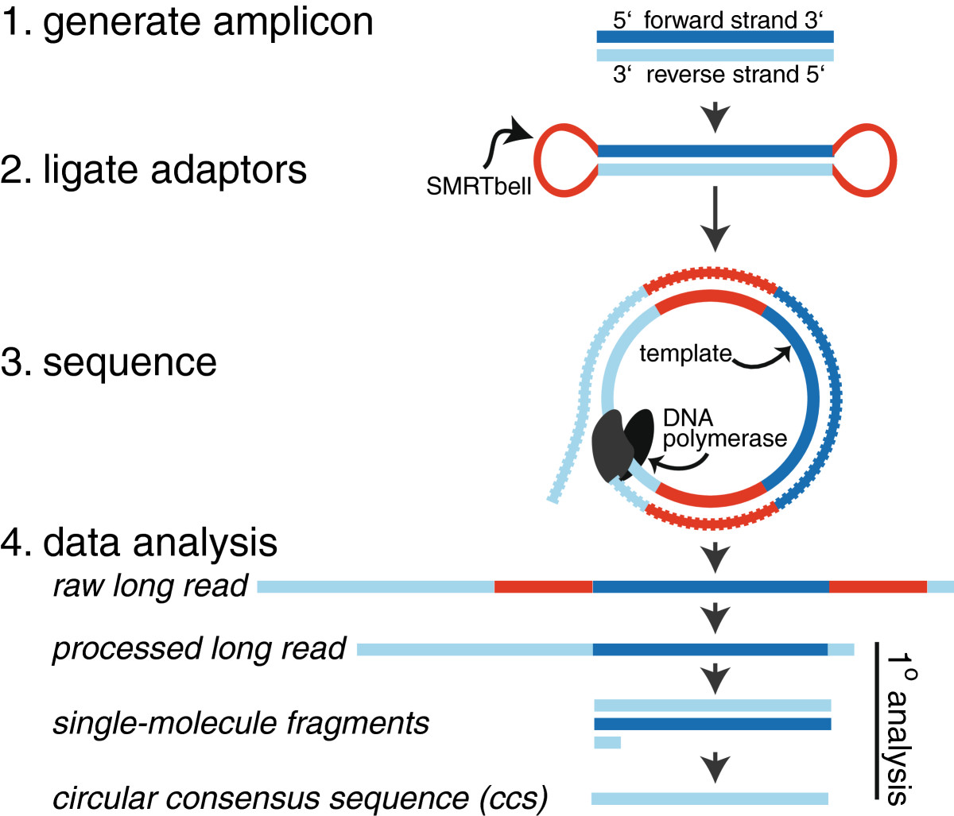
1.2
RenSeq with 3-4kb CCS PacBio reads
3-4 kb NLR-enriched library
PacBio: long reads with high error rate
Solution: Circular Consensus Sequencing (CCS)

Slide 11
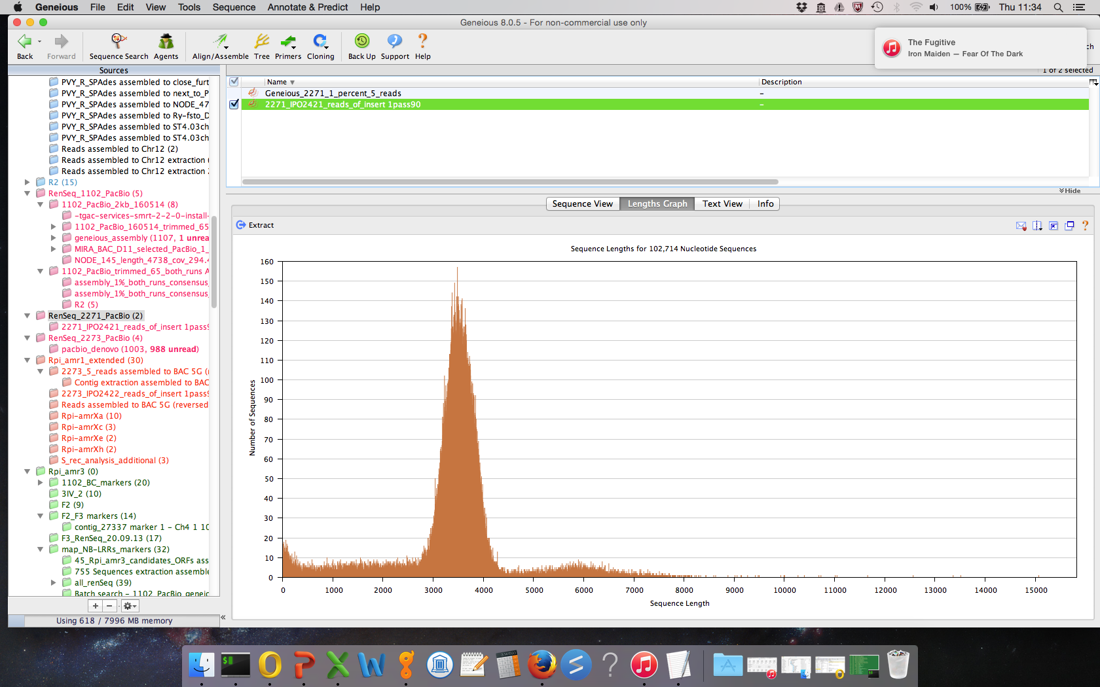
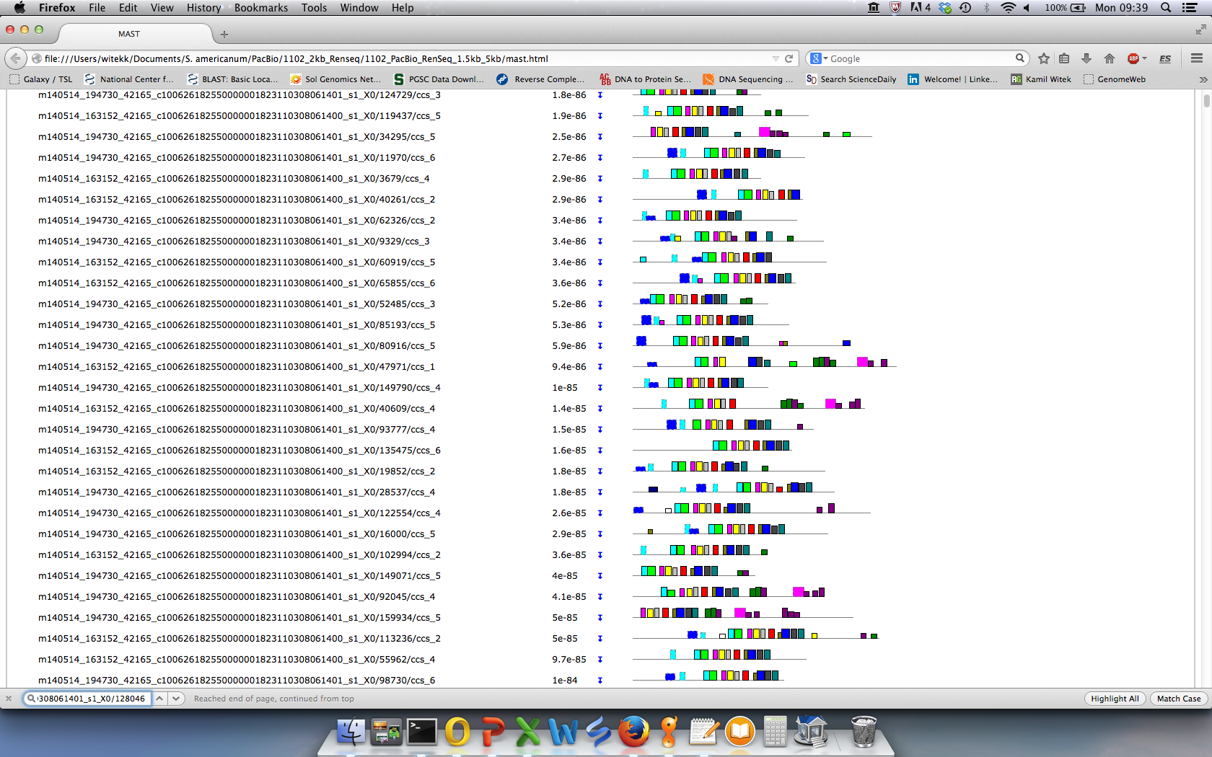
1.2
SMRT RenSeq enables assembly of NLR loci
Read length distribution
Full NLRs in single reads
CC
NB_ARC
LRR
3 kb
4 kb
Witek, Jupe et al. (2016) Nat Biotechnol

Slide 12
1.2
SMRT RenSeq enables assembly of NLR loci
Read length distribution
Full NLRs in single reads
CC
NB_ARC
LRR
3 kb
4 kb
PacBio RenSeq de novo assembly: contigs with several NLRs
1.6 kb
5.2 kb
MiSeq
PacBio
pseudogenised NLR
full-length NLR
Witek, Jupe et al. (2016) Nat Biotechnol

Slide 13
1.2
MinION RenSeq results in comparable assembly to SMRT RenSeq
Giolai et al. (2017) BMC Genomics

Slide 14
Presentation overview
1. Introduction - plant immune system
Disease resistance genes
RenSeq
2. Basic research
NLR complements of Solanaceae
3. Cloning of functional resistance genes
RenSeq with Bulked Segregant Analysis
MutRenSeq
4. Applied research
transgenic field trials
Maris Piper⁺ (HAPI project)

Slide 15
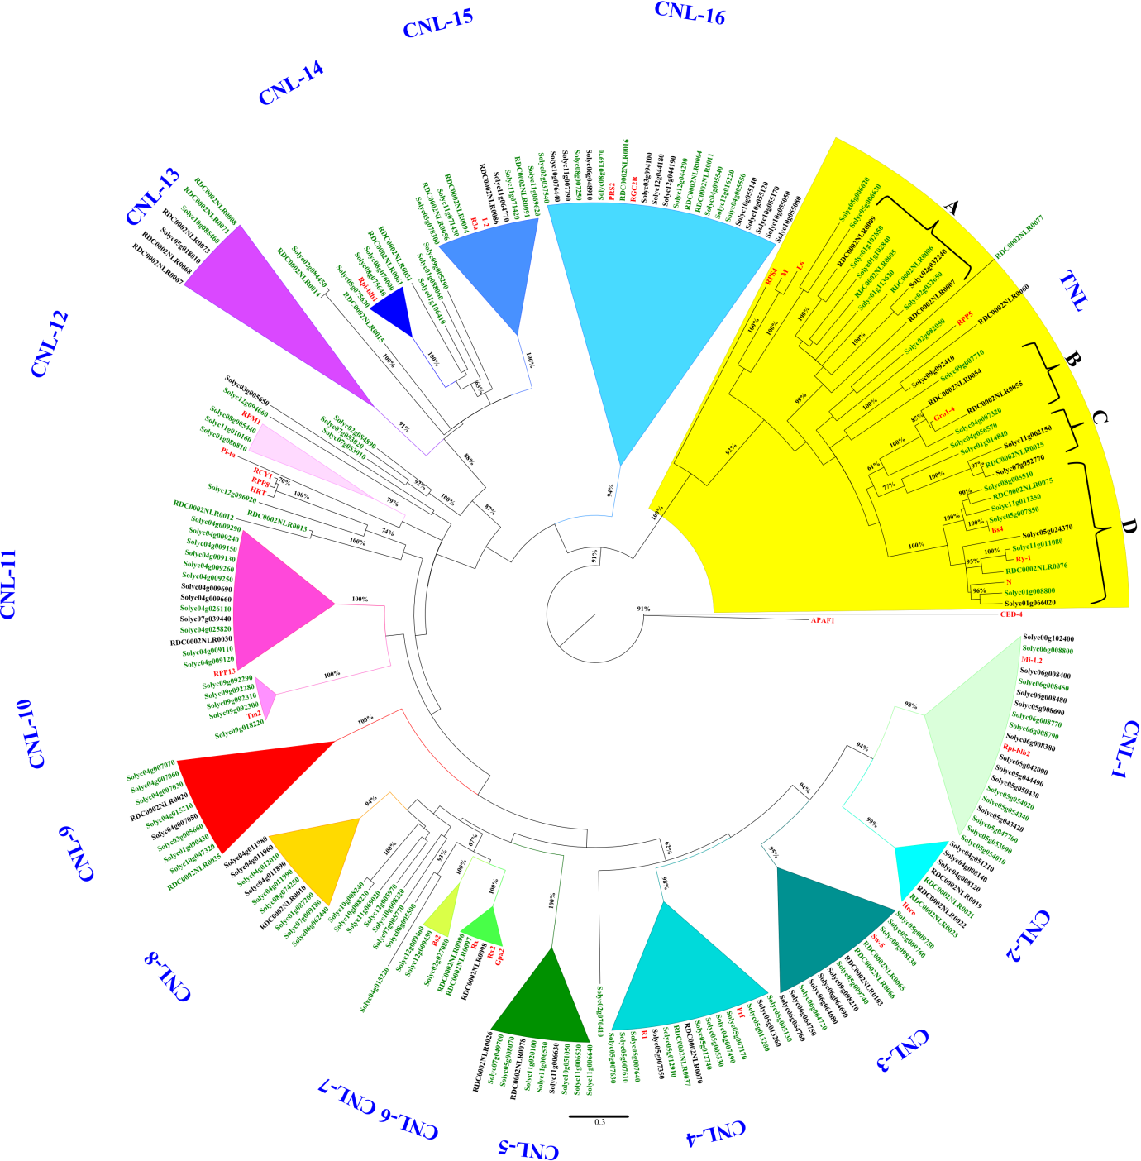
2.1
Phylogenetic analysis of tomato NLR genes
Solanum lycopersicum Heinz 1706
Maximum-Likelihood analysis of NB-ARC domain
CNL more abundant than TNL
High similarity of groups to potato NB-LRR
Andolfo et al. (2014) BMC Plant Biol

Slide 16
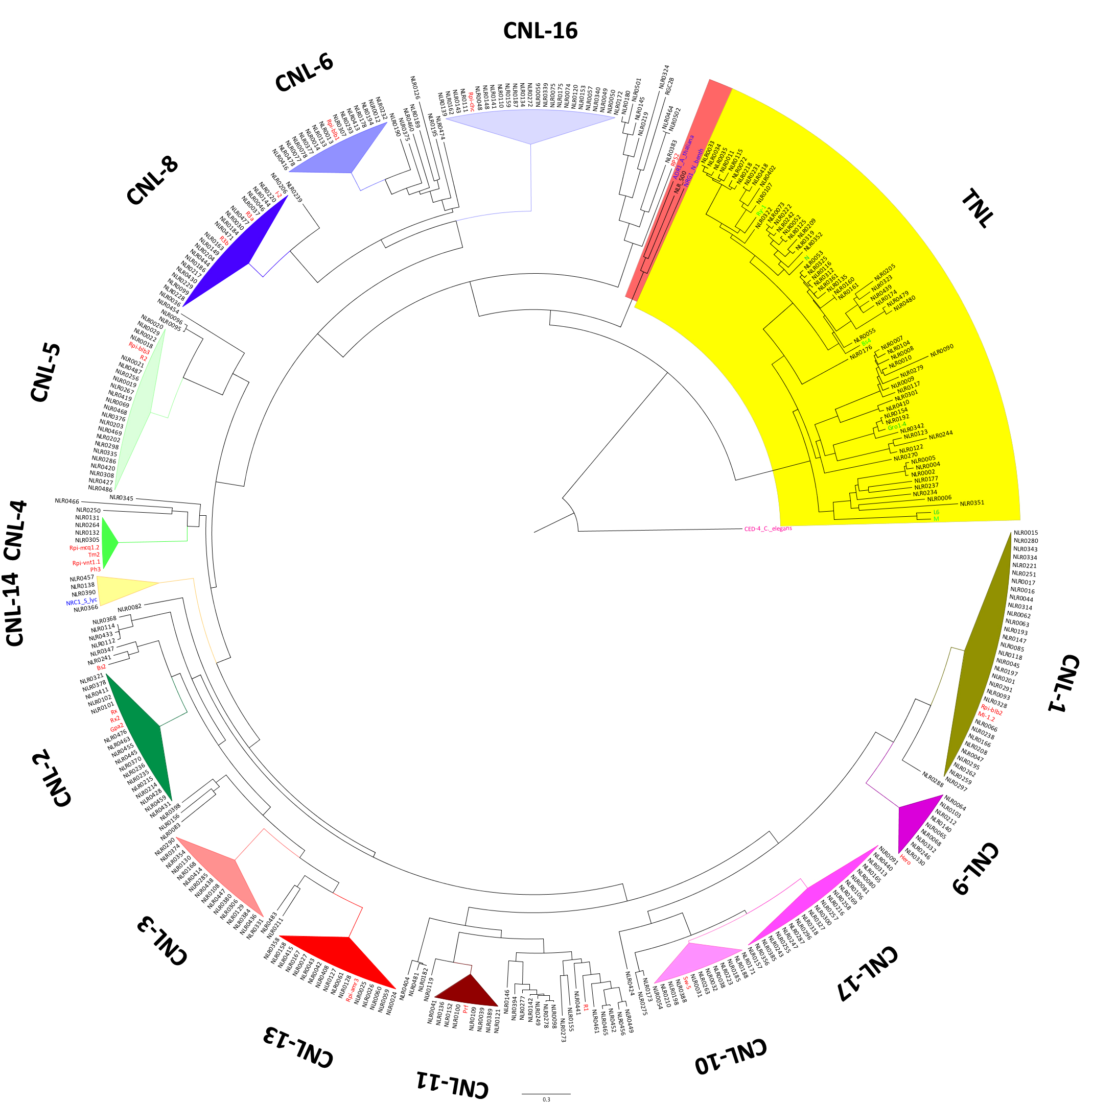
2.1
Phylogenetic tree of Solanum americanum NLRs
Witek, Jupe et al. (2016) Nat Biotechnol

Slide 17
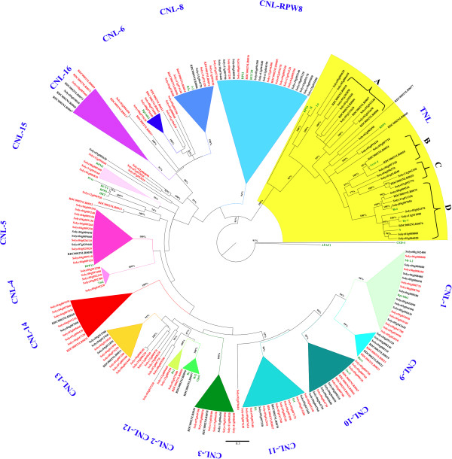
2.1
Phylogenetic tree of Solanum americanum NLRs
constructed from SMRT RenSeq assembly
Witek, Jupe et al. (2016) Nat Biotechnol
Andolfo et al. (2014) BMC Plant Biol

Slide 18
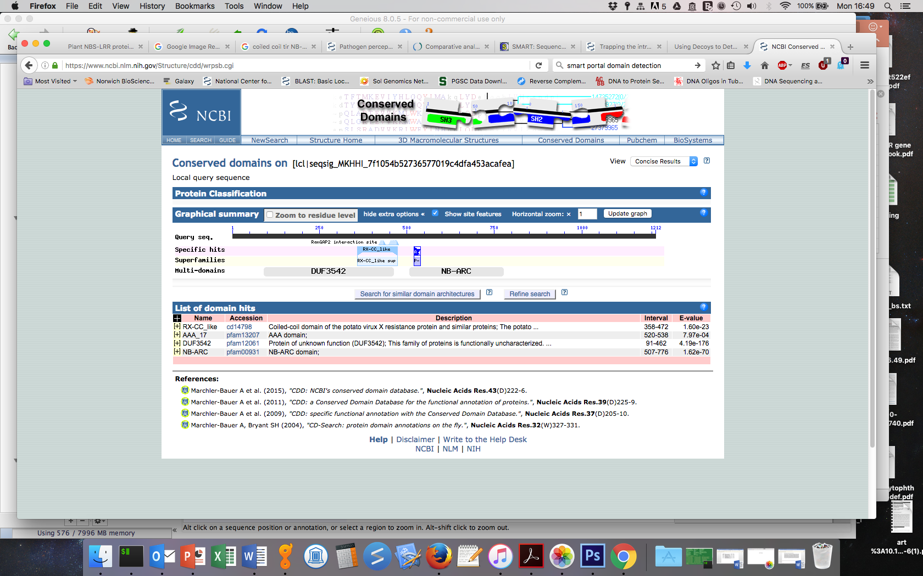
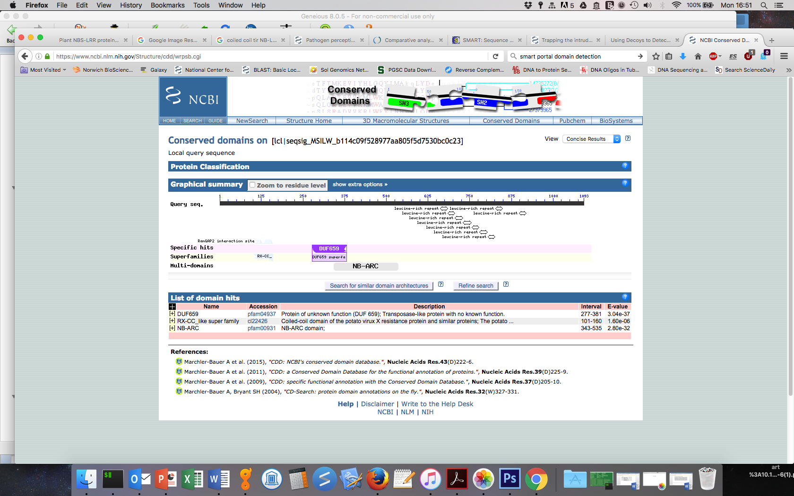
2.1
Solanaceae NLRs have few non-canonical domain fusions
 | Fused domain
28 | DUF3542
2 | ASF-like histone chaperone
1 | DUF659
1 | PTPc super family
1 | RNA_pol_3_Rpc31 super family
Witek, Jupe et al. (2016) Nat Biotechnol

Slide 19
Presentation overview
1. Introduction - plant immune system
Disease resistance genes
RenSeq
2. Basic research
NLR complements of Solanaceae
3. Cloning of functional resistance genes
RenSeq with Bulked Segregant Analysis
MutRenSeq
4. Applied research
transgenic field trials
Maris Piper⁺ (HAPI project)
Notes:
Which is doing the job
How to select it from hundreds to thousand genes

Slide 20
3.1
Cloning functional NLRs – looking for the needle in a haystack

Slide 21
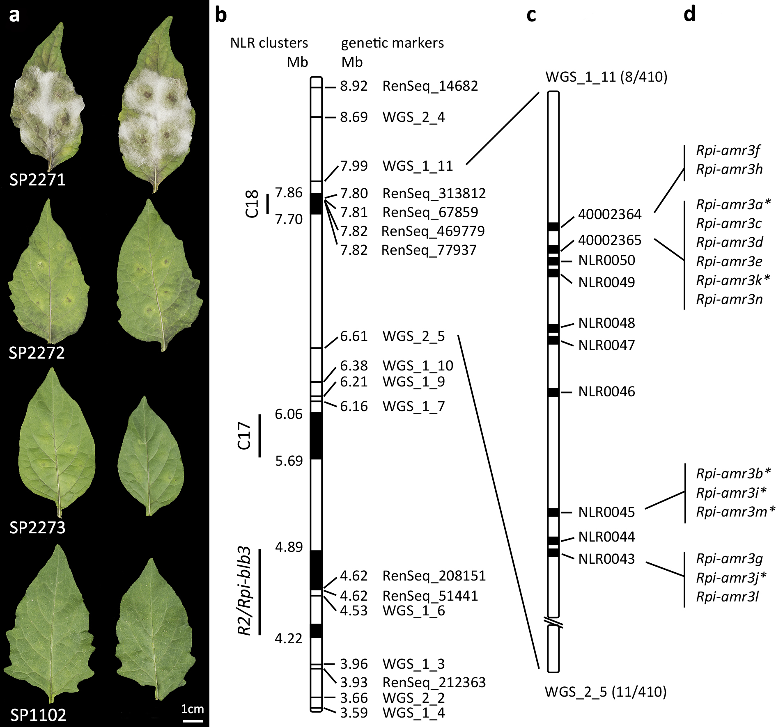
3.1
Mapping resistance genes in diploid inbred lines:
Bulked Segregant analysis (BSA)
susceptible
resistant
Rpi1
x
P. infestans growth
P. infestans resistant
F1
resistant
F2
susceptible
F2
Number of resistance genes determines segregation ratio in F2

Slide 22
3.1
Linked polymorphisms in simplified BSA analysis
susceptible
reads
resistant
reads
SMRT RenSeq
reference
BS
reads
50%
50%
100%
0%
60%
40%

Slide 23
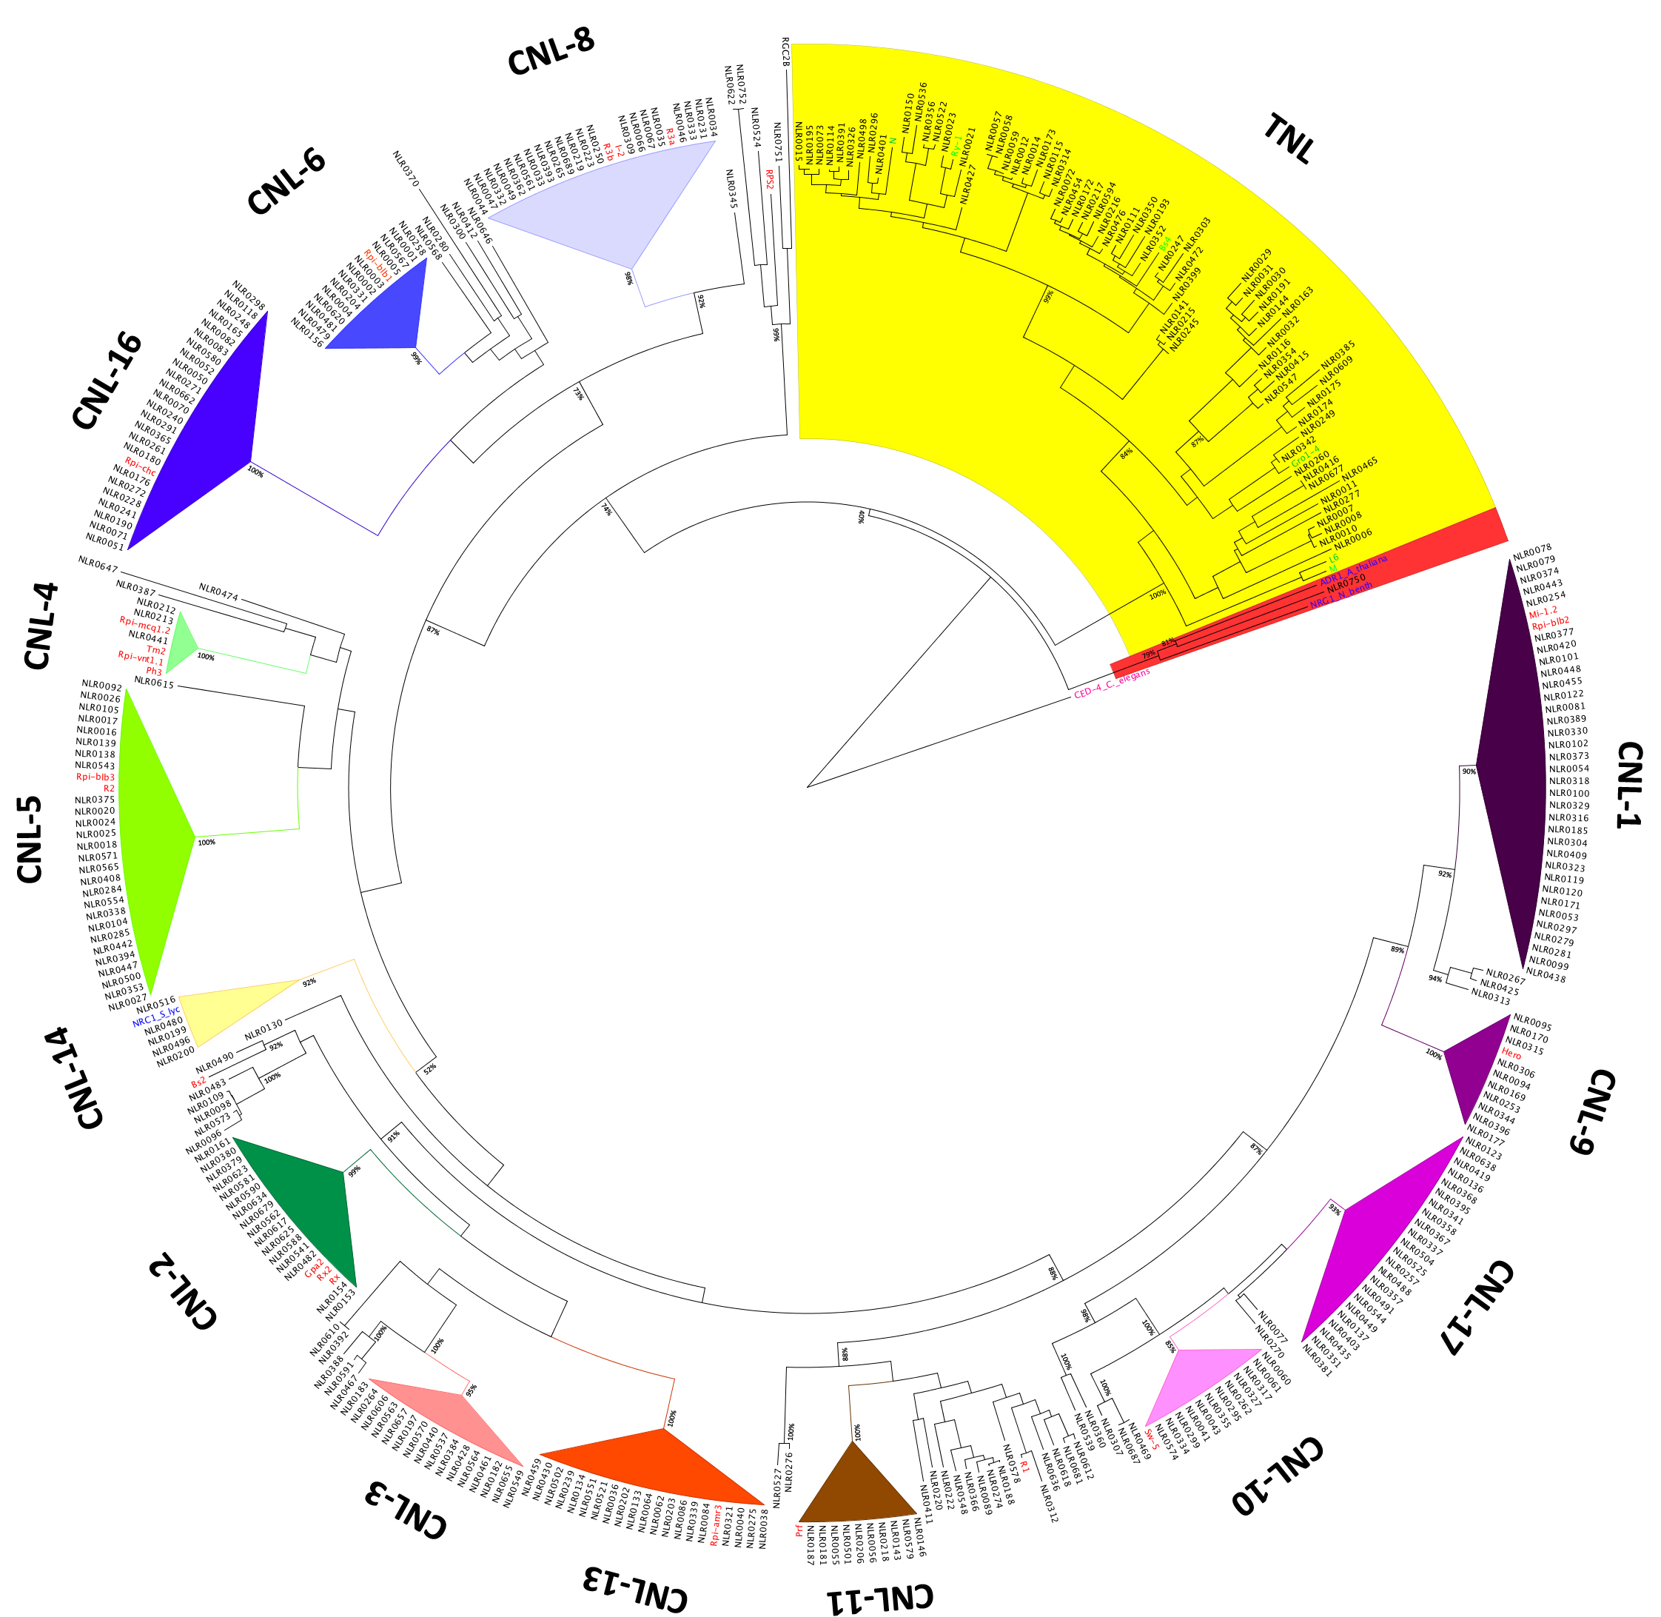
3.1
RenSeq data limits Rpi-amr1 to 11 candidate NLRs
SMRT RenSeq on R parent
~650 NLRs
MiSeq RenSeq on 100 S plants from F2
Expressed genes based on cDNA RenSeq
11 candidates for Rpi-amr1
unpublished

Slide 24
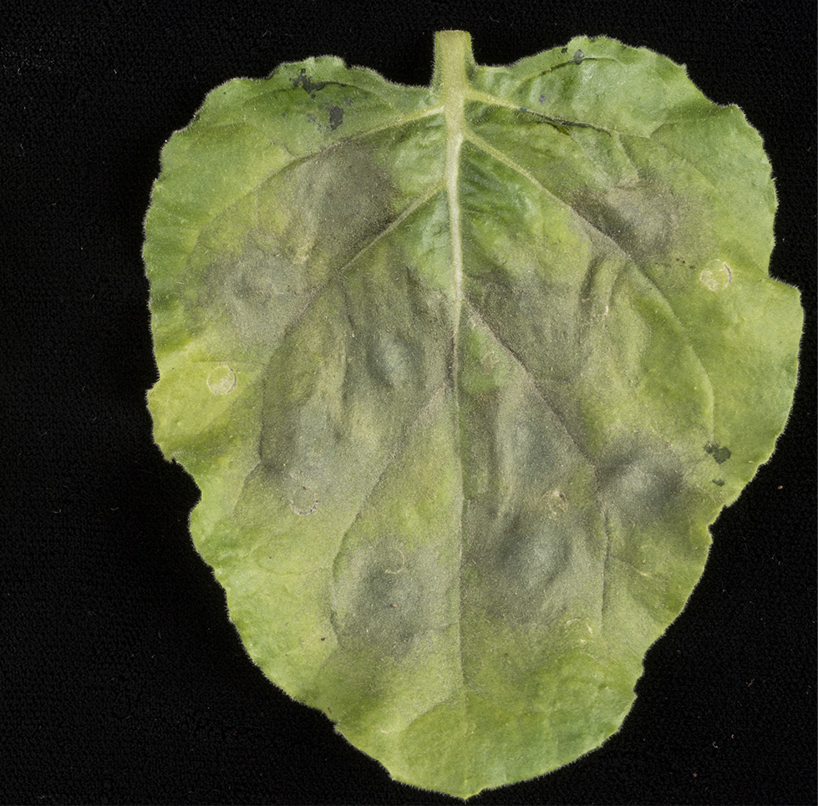
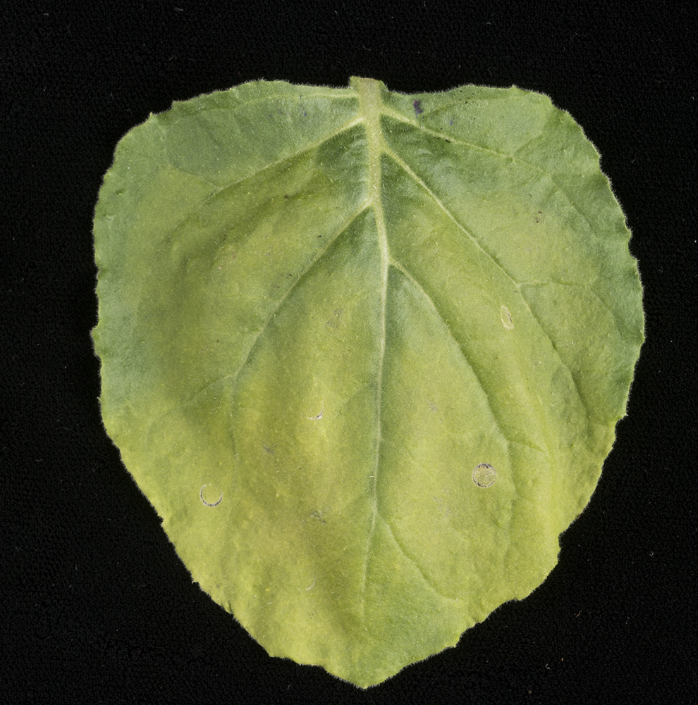
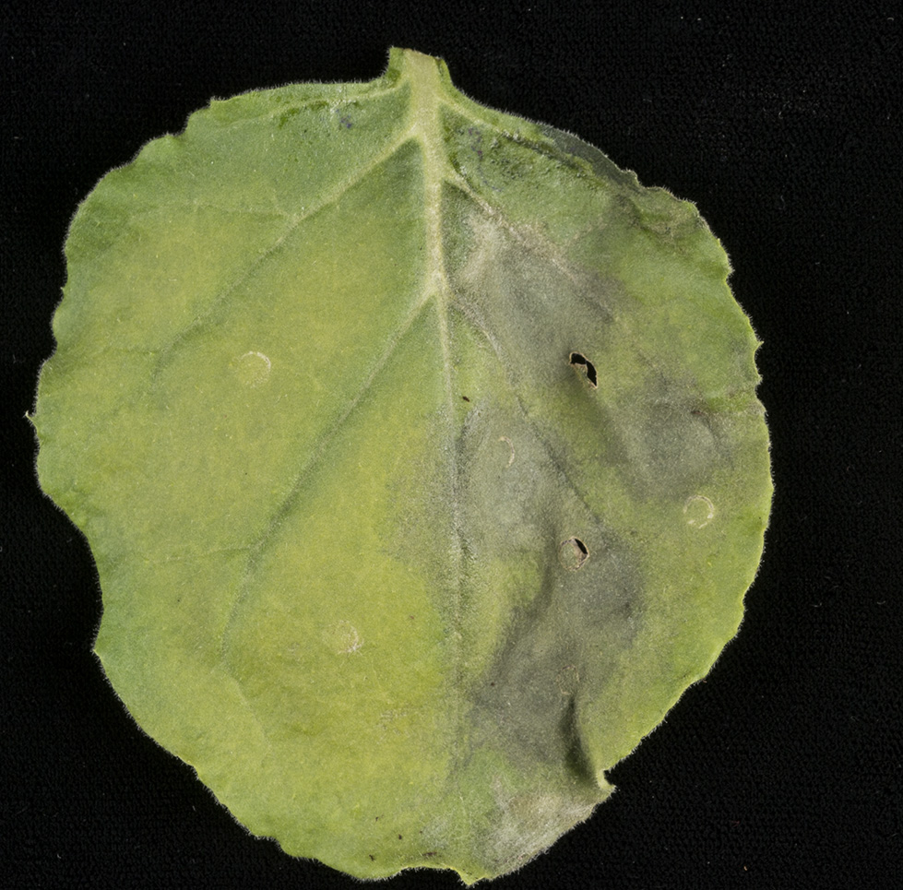
3.1
Rpi-amr1 confers resistance against P. infestans strain transient
assay in N. benthamiana
amr1e
amr1c
negative control
(pathogen growth)
know resistance gene
(pathogen growth restricted)
tested genes
BSA with RenSeq is faster and cheaper than standard map-based cloning
no fine mapping
no BAC library construction
unpublished

Slide 25
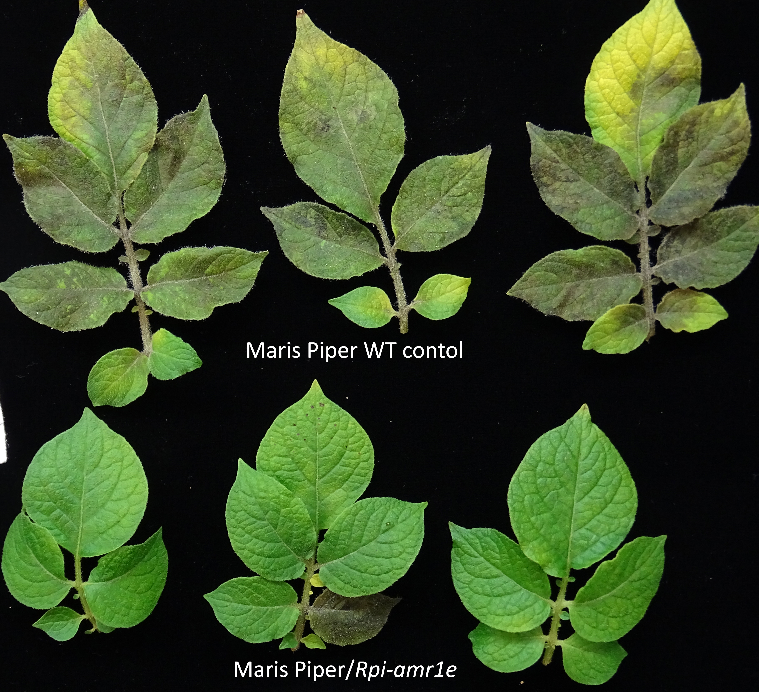
3.1
Stable transgenic plants with Rpi-amr1 under native regulatory
elements confer resistance against P. infestans isolates
unpublished

Slide 26




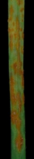
3.2
RenSeq combined with Mutational Genomics (MutRenSeq)
Traditional way: Map-based cloning
Depends on recombination (centromere!)
Alternative way: Mutational Genomics
EMS mutagenesis
wild type
resistant plant
M2
Steuernagel et al. (2016) Nat Biotechnol

Slide 27
3.2
MutRenSeq pipeline
Mutant Hunter
Wildtype contig annotation
(oversensitive) SNP calling
Presence / Absence calling
Data integration
RenSeq
Mapping
De novo assembly
Contig Annotation
Mutant Hunter
>candidate_contig_1
wildtype: ATGCTTAGCGGCATAGCACGCCCTAG
mutant₁ : ATACTTAGCGGCATAGCACGCCCTAG
mutant₂ : ATGCTTAACGGCATAGCACGCCCTAG
mutant₃ : ---------deletion---------
…
mutant_{n} : ATGCTTAGCGGCATAGCACGTCCTAG
Steuernagel et al. (2016) Nat Biotechnol
Notes:
5-6 mutants

Slide 28

3.2
Cloning of stem rust resistance gene (Sr22) with MutRenSeq
Sr22 locus
bp
2,500
5,000
7,500
8,957
2S
*
7S
1S
3S1
*
6S
5S1
Steuernagel et al. (2016) Nat Biotechnol

Slide 29
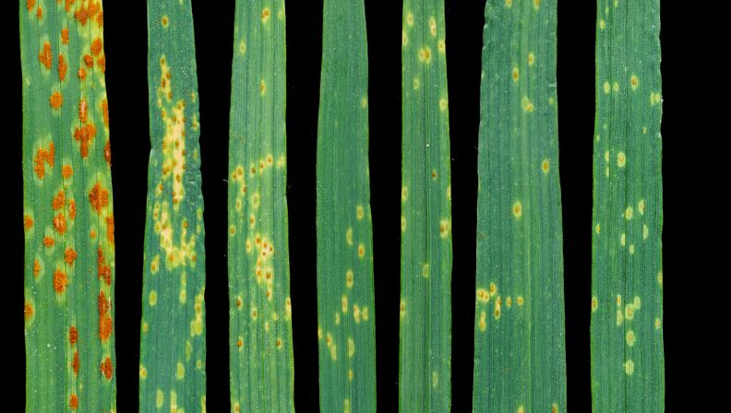
3.2
Cloning of stem rust resistance gene (Sr22) with MutRenSeq
Sr22 locus
bp
2,500
5,000
7,500
8,957
2S
*
7S
1S
3S1
*
6S
5S1
Stable transgenic plants carrying Sr22 are resistant to stem rust
WT Fielder
Fielder/Sr22 lines
Steuernagel et al. (2016) Nat Biotechnol

Slide 30
Presentation overview
1. Introduction to plant immune system
Plant resistance genes
RenSeq
2. Basic research
NLR complements of Solanaceae
3. Cloning of the functional resistance genes
RenSeq with Bulked Segregant Analysis
MutRenSeq
4. Application research
field trials of functional late blight gene
Improved cv. Maris Piper (HAPI project)

Slide 31
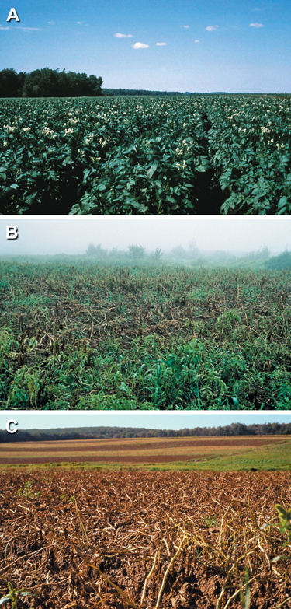
4.1
P. infestans: fungicide treatment in conventional potato production
Phytophthora infestans: The plant (and R gene) destroyer. William Fry (2008) MPP
William Fry (2008) MPP
requires multiple sprays in each growing season
on average, 10-12 sprays in the UK
in Northern Europe up to 25 sprays in wet years (Belgium, 2007-2008)

Slide 32
4.1
Rpi-vnt1.1 provides good level of resistance against
UK isolates of P. infestans
30-50% reduction in tuber yield in non-transgenic plants
Jones, Witek, et al. (2013) Phil. Trans. Roy. Soc. B

Slide 33
4.1
R gene stacking for more durable resistance
Introgression of single R gene: effective but not durable
Pathogens can quickly overcome single R genes by mutating or silencing cognate effectors
Stacking of R genes that recognise different effectors should provide more durable resistance
GM (or editing ) is essential
Jones, Witek, et al. (2013) Phil. Trans. Roy. Soc. B

Slide 34
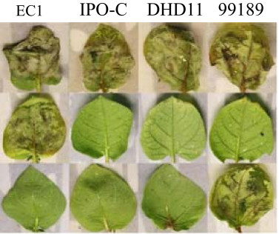
4.1
Previously cloned Rpi genes have their virulent P. infestans strains
Rpi gene | Species
Rpi-chc | S. chacoense
Rpi-blb1 | S. bulbocastanum
Rpi-blb2 | S. bulbocastanum
Rpi-blb3 | S. bulbocastanum
Rpi-abpt | S. bulbocastanum
Rpi-bt1 | S. bulbocastanum
R1 | S. demissum
R2 | S. demissum
R3a | S. demissum
R3b | S. demissum
R8 | S. demissum
Ph-3 | S. lycopersicum
Rpi-mcq1 | S. mochiquense
Rpi-sto1 | S. stoloniferum
Rpi-sto2 | S. stoloniferum
Rpi-pta1 | S. stoloniferum
Rpi-vnt1.1 | S. venturii
P. infestans isolates
Control
Rpi-vnt1.1
Rpi-sto1
ELR
S. microdontum
Modified from Rodewald and Trognitz (2013) MPP
Jo at al. (2014) BMC Biotechnol

Slide 35





4.2
Improved version of UK most favorite potato Maris Piper
Marina Pais

Slide 36
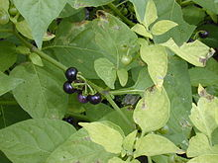
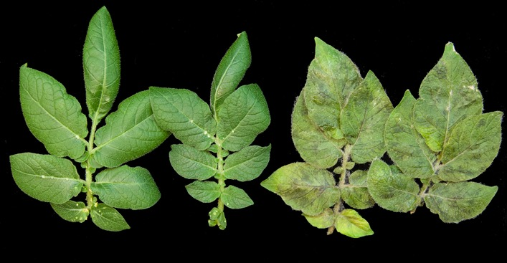
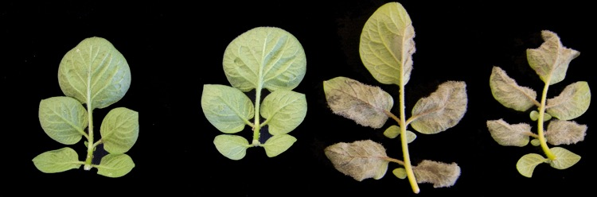
4.2
Three-Rpi-gene stack that combines resistance genes from wild relatives of potato
Rpi-vnt1
Rpi-amr3
Rpi-amr1e
different specificities
not used in breeding previously
Solanum americanum
Maris Piper / Rpi-amr3
Maris Piper
Solynta / Rpi-amr1e
Solynta

Slide 37
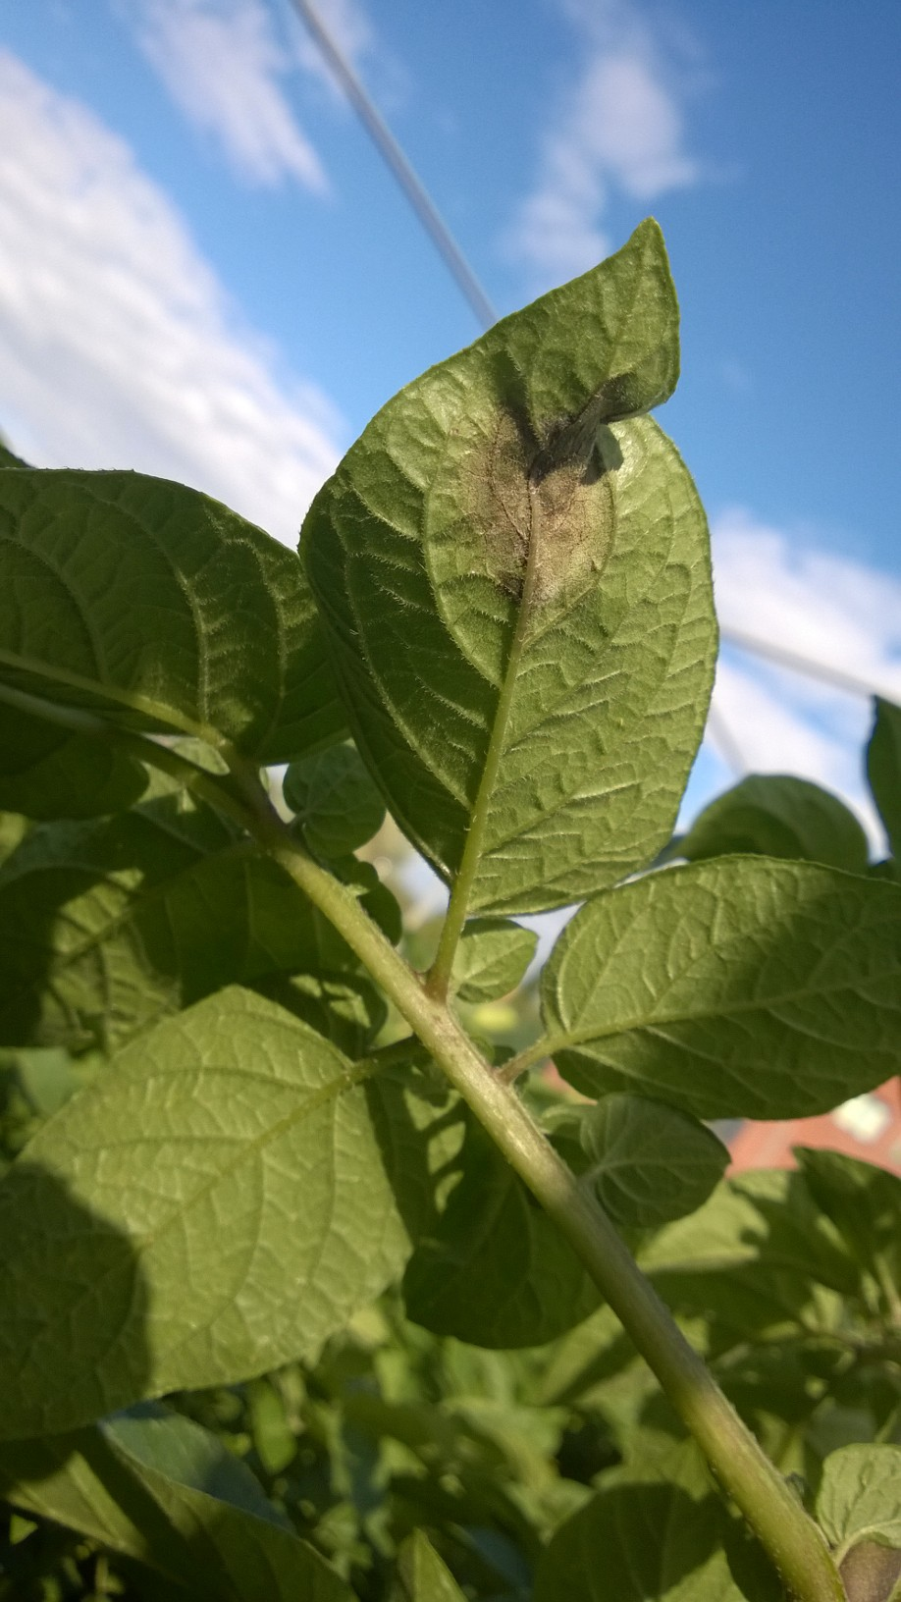
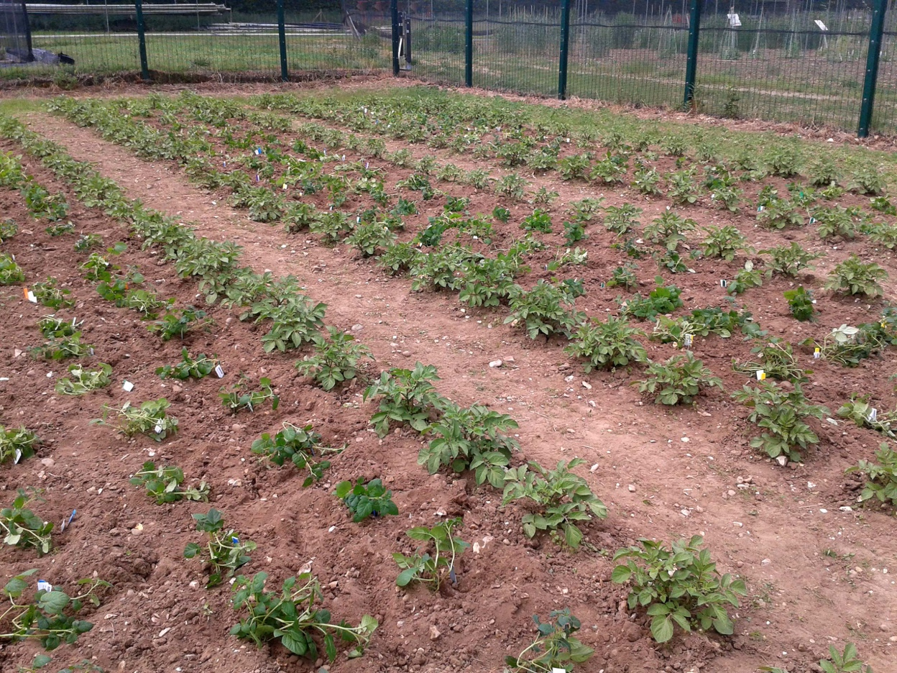
4.2
Three-Rpi-gene stack and single genes
being tested in field trials in 2017
LB
CSR
Rpi-vnt1
RBO
7.8 kb
LB
CSR
Rpi-amr3
RBO
9.0 kb
LB
CSR
Rpi-amr1e
RBO
9.5 kb
LB
CSR
Rpi-vnt1
Rpi-amr3
Rpi-amr1e
RBO
18.7 kb
Notes:
Preselected lines show resistance in phenotyping assays (detached-leaf assay, different isolates and inoculums) and expression of the 3 Rpi genes (in case of the stack).
Expression of the 3 genes was checked as a proxy for functionality, while we investigate what are the cognate effectors and build a differential set of isolates.
From those lines, the ones displaying higher degree of resistance and better phenotype in the GH were selected for the field (2 for the single Rpi genes, 4 for the stack).

Slide 38
Take home messages
SMRT RenSeq allows to capture full NLR complements
detailed characterization of NLRs
phylogenetic studies
NLR diversity studies
MutRenSeq and RenSeq
quick cloning of the functional resistance genes (~2 years)
cheaper – no BAC libraries or fine mapping
HAPI project – new super resistant Maris Piper potato!

Slide 39





Acknowledgments
Funding:
Jonathan Jones
Marina Pais
Agnieszka Witek
Hari Karki
Laurence Tomlinson
Florian Jupe
Giuseppe Andolfo
Oliver Furzer
Matthew Smoker
Jodie Pike
Sara Perkins
Justine Campling
Burkhard Steuernagel
Brande Wulff
Matthew Clark
David Baker
Collaborators:
Detlef Weigel, MPI Tubingen
Jeff Dangl, UNC Chapel
Peter Urwin, University of Leeds
Sylvestre Marillonnet, LIPB Halle
Simplot Plant Sciences
Biopotatoes

Slide 40
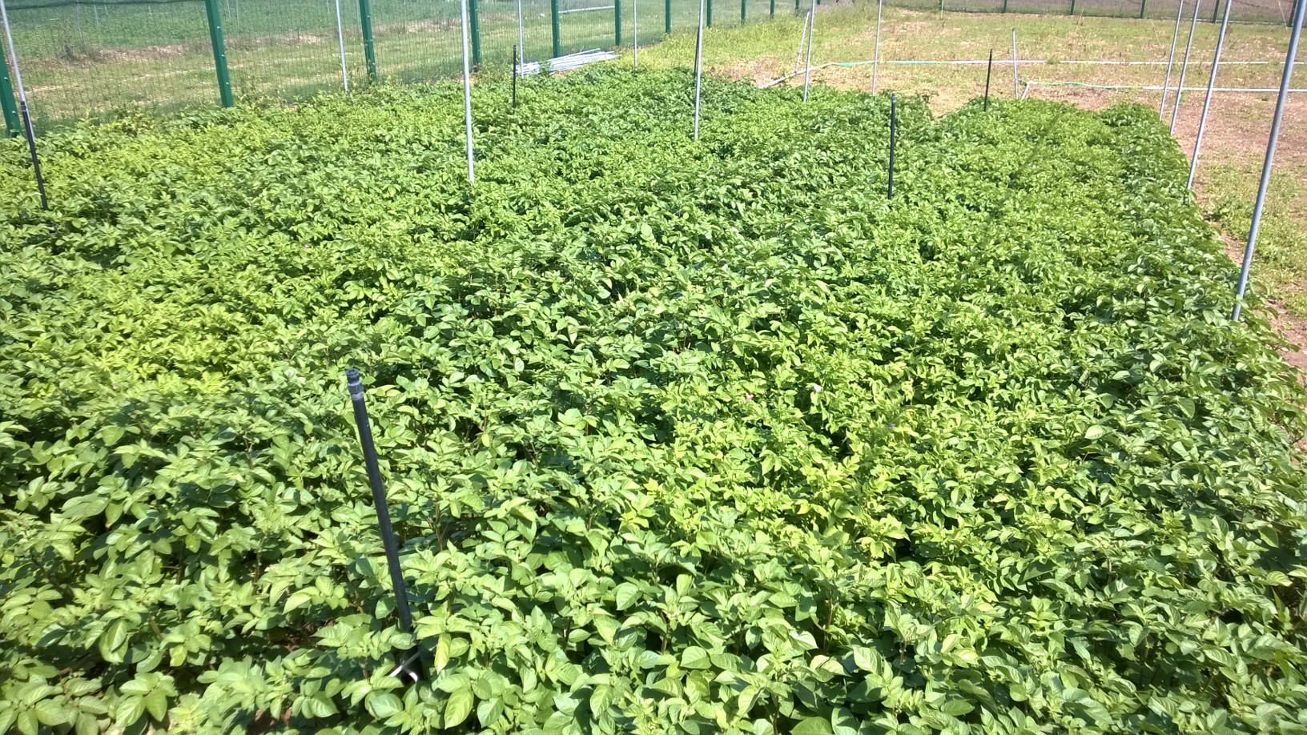

Slide 41
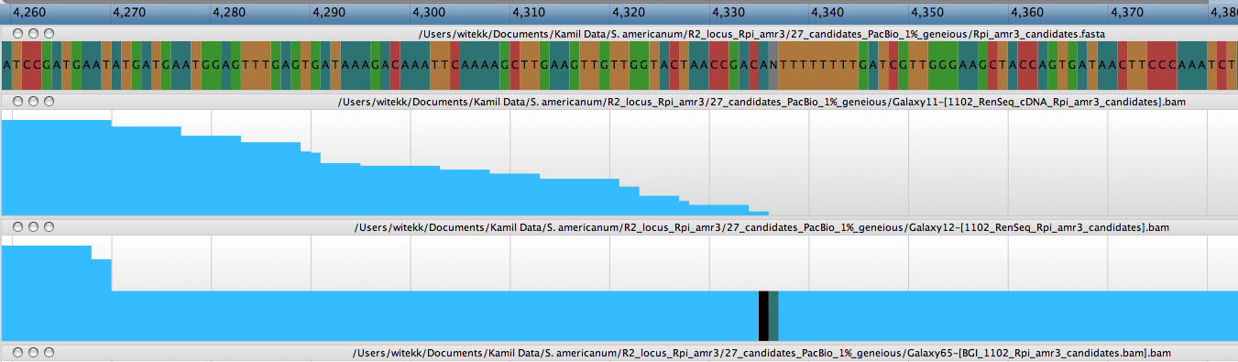
1.2
Single InDels in homopolymeric regions of SMRT RenSeq assembly
Witek, Jupe et al. (2016) Nat Biotechnol

